Slide 1

English Premier League: What makes a winner
Anthony Meyers, Danny Moncada, & Frankie Cancino

Slide 2
English Premier League - Contextual Overview
# 1 Football (Soccer) League in the world - Bleacher Report
Average per match television audience for NBC: 449,000
Top four teams receive automatic entry into the group stages of the UEFA Champions League:
Team earns €15,250,000 for qualifying
The 2012-2013 final at Wembley Stadium drew 360 million television viewers worldwide

Slide 3
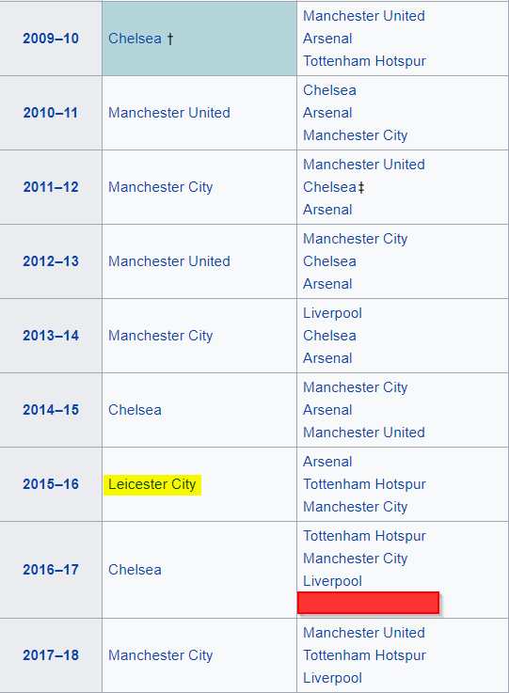

Problem
Season | Champion | Runner Ups
Make effective marketing decisions by understanding the factors that influence a team’s final standings
This will be vital to how teams and matches are highlighted for marketing potential
Understanding these variables will allow effective deployment of marketing capital
Leicester City, who started the season with a 5,000 to 1 chance to win the Premier League, hoist the trophy at the end of the 2015-2016 season
Premier League Top 4 Finishers, ‘09-’10 to Present
Notes:
Identifying

Slide 4
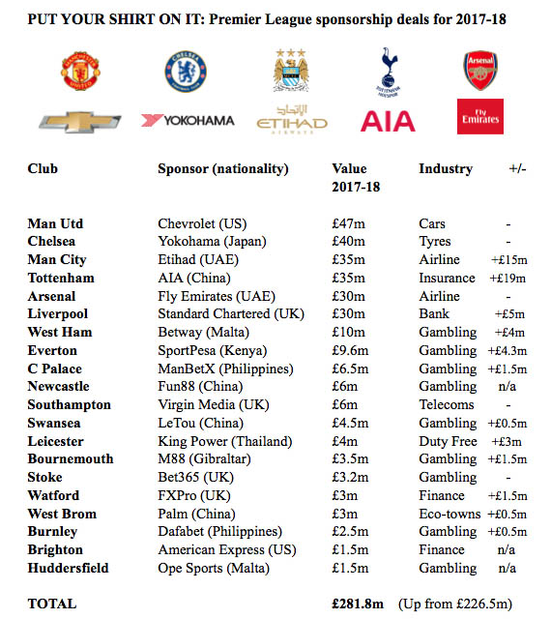
Problem
Sponsorship deals increasing in value for top performing teams
English Premier League also increasing advertising opportunities
Analysis can also supplement consulting capabilities for companies looking to bid on english premier league sponsorships

Slide 5
Avenues of Exploration
Identify the top teams
Identify the top matches
What data is out there?
Goals scored, yellow/red cards received, number of saves per match, number of shots (on/off target)
What model do we create?
Multiple linear regression
What can we conclude?
Iterate
Notes:
Essentially a brief overview of what the rest of the presentation is about.
We want to identify the top teams for effective marketing, how do we do this? And then iterate over the experiments (look at new data, switch up k-value, etc.)
-Iterate over each time the scientific method, and experiment with different models
-We can see how top teams are doing week by week

Slide 6
Data: English Premier League Results 2009 - 2018
https://datahub.io/sports-data/english-premier-league#r
Dataset contains data for last 10 seasons of English Premier League including the current season (over 3,000 matches)
The data is refreshed weekly
Predictors for our model (for both home and away)
Goals For, Home Goals Against
Shots, Shots on Target
Fouls, Fouls Against
Yellow/Red Cards for, Yellow/Red Cards against
Notes:
http://www.football-data.co.uk/

Slide 7
Analyses: Different k-values
model | k | r-squared | s | p-value
All predictors | 22 | 0.8581877 | 2.325087 | 2.20E-16
Goals and Shots | 8 | 0.8510219 | 2.28347 | 2.20E-16
Goals | 4 | 0.8492233 | 2.270806 | 2.20E-16
Net Goals | 1 | 0.8442622 | 2.288332 | 2.20E-16
While the k = 4 model is more complex than the k = 1 model, with relatively similar summary statistics, the k = 4 betas provide more actionable predictors than the k = 1 model

Slide 8
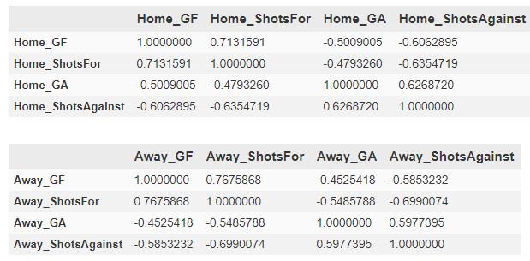
Analyses
Collinearity amongst many of the original predictor values
Home & Away Goals directly linked to Shots For and Shots Against
Notes:
-Collinearity checking was done to help slim down the model from the original predictor set of values, which at 22 leaves a lot of room for them to be collinear (or essentially, related to one another)
- In this example, we observed that Home & Away Goals were directly linked to Shots For and Shots Against, which made them redundant and not needed

Slide 9
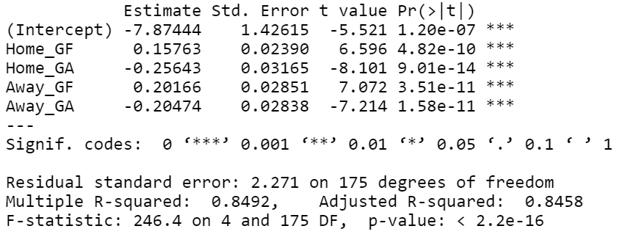
Analyses: Coefficients (k = 4)
85% of variation in the final standing of a team is explained by season totals of goals for and goals against, split by home and away matches, respectively

Slide 10
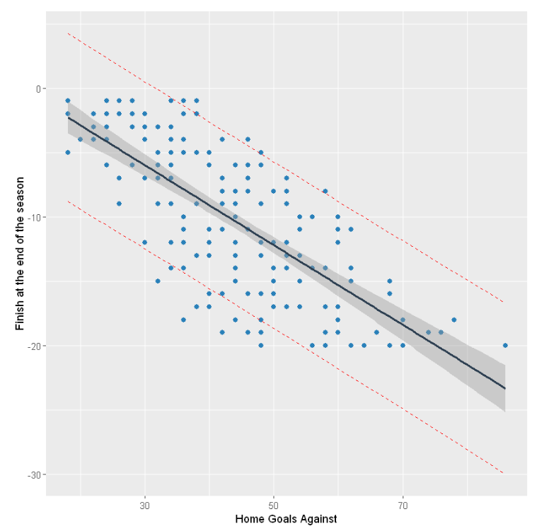
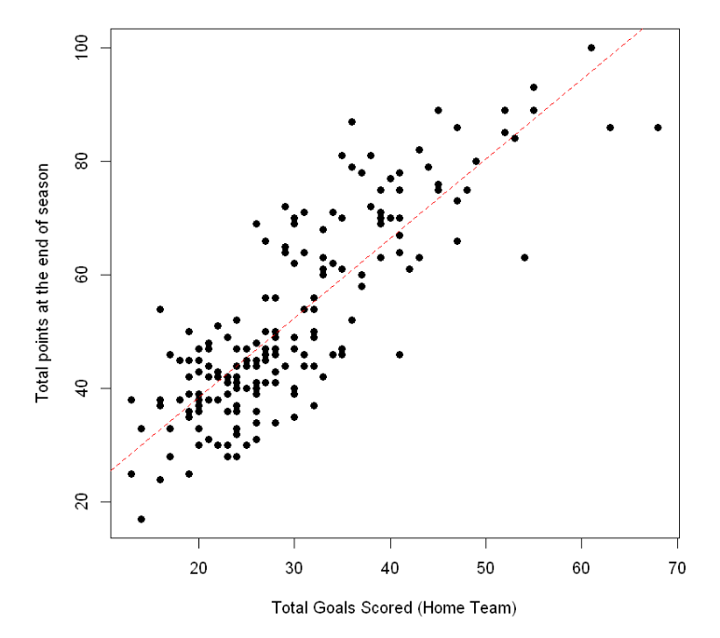
Analyses: Home Form
Notes:
First graph was so that we could confirm that conceding the fewest amount of goals at home would lead to a higher finish at the end of a season
Second graph was to determine if there was a relationship between how many goals were scored at home and how many points the team had at the end of the season (more points = higher finish)

Slide 11
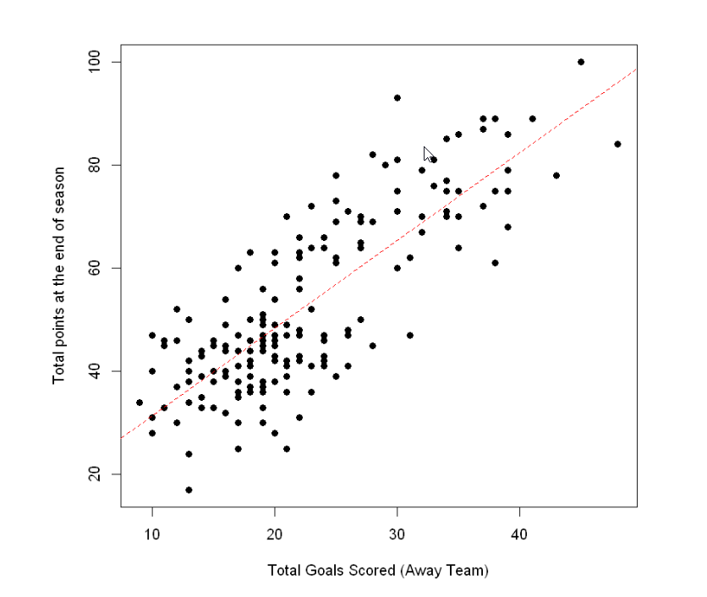
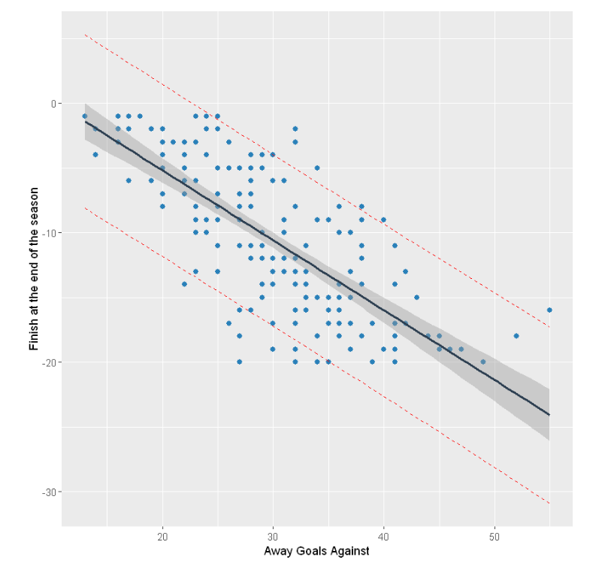
Analyses: Away Form
Notes:
Conceding the fewest amount of goals away would lead to a higher finish at the end of a season
Determine relationship between how many goals were scored away and how many points the team had at the end of the season (more points = higher finish)

Slide 12
Analyses: Coefficients (k = 4)
 |  |  |  | 90% Confidence Interval
Predictor | Description | β | Estimate | 5% | 95%
Home_GF | Goals for at home stadium | β1 | 0.15763 | 0.11811 | 0.19714
Home_GA | Goals against at home stadium | β2 | -0.25643 | -0.30877 | -0.20408
Away_GF | Goals for at away stadiums | β3 | 0.20166 | 0.15450 | 0.24881
Away_GA | Goals against at away stadiums | β4 | -0.20474 | -0.25167 | -0.15781
Confidence intervals define the range in which the true population effect of the predictors will lie

Slide 13
Conclusion
The estimates from the linear model provide predicted value changes in the final standing of a team based on goals for and goals against as the home and away team, respectively
These predictors can be utilized to efficiently deploy marketing capital to the team segments (cities, fans, etc.) to maximize earned revenue or to maximize broadcasting capital to potentially high profile matches

Slide 14
Outcomes
Based on the k=4 model of goals, from our sampling:
Scoring a goal as the away team is 27.9% more valuable than a home goal to a higher finish
Conceding a goal at home is 25.2% more damaging than conceding a goal away
Consider heavier marketing towards teams that score at high rates as the visiting team and that do not concede goals at home

Slide 15
Follow-up
With further research and data, predictors of the goals for and goals against predictors could supplement the analysis and allow for prediction and forecasting capabilities
Further evaluation of market research can compliment analytical approaches for counter cases that fall out of the scope of the analysis results

Slide 16
Questions?

